Slide 1
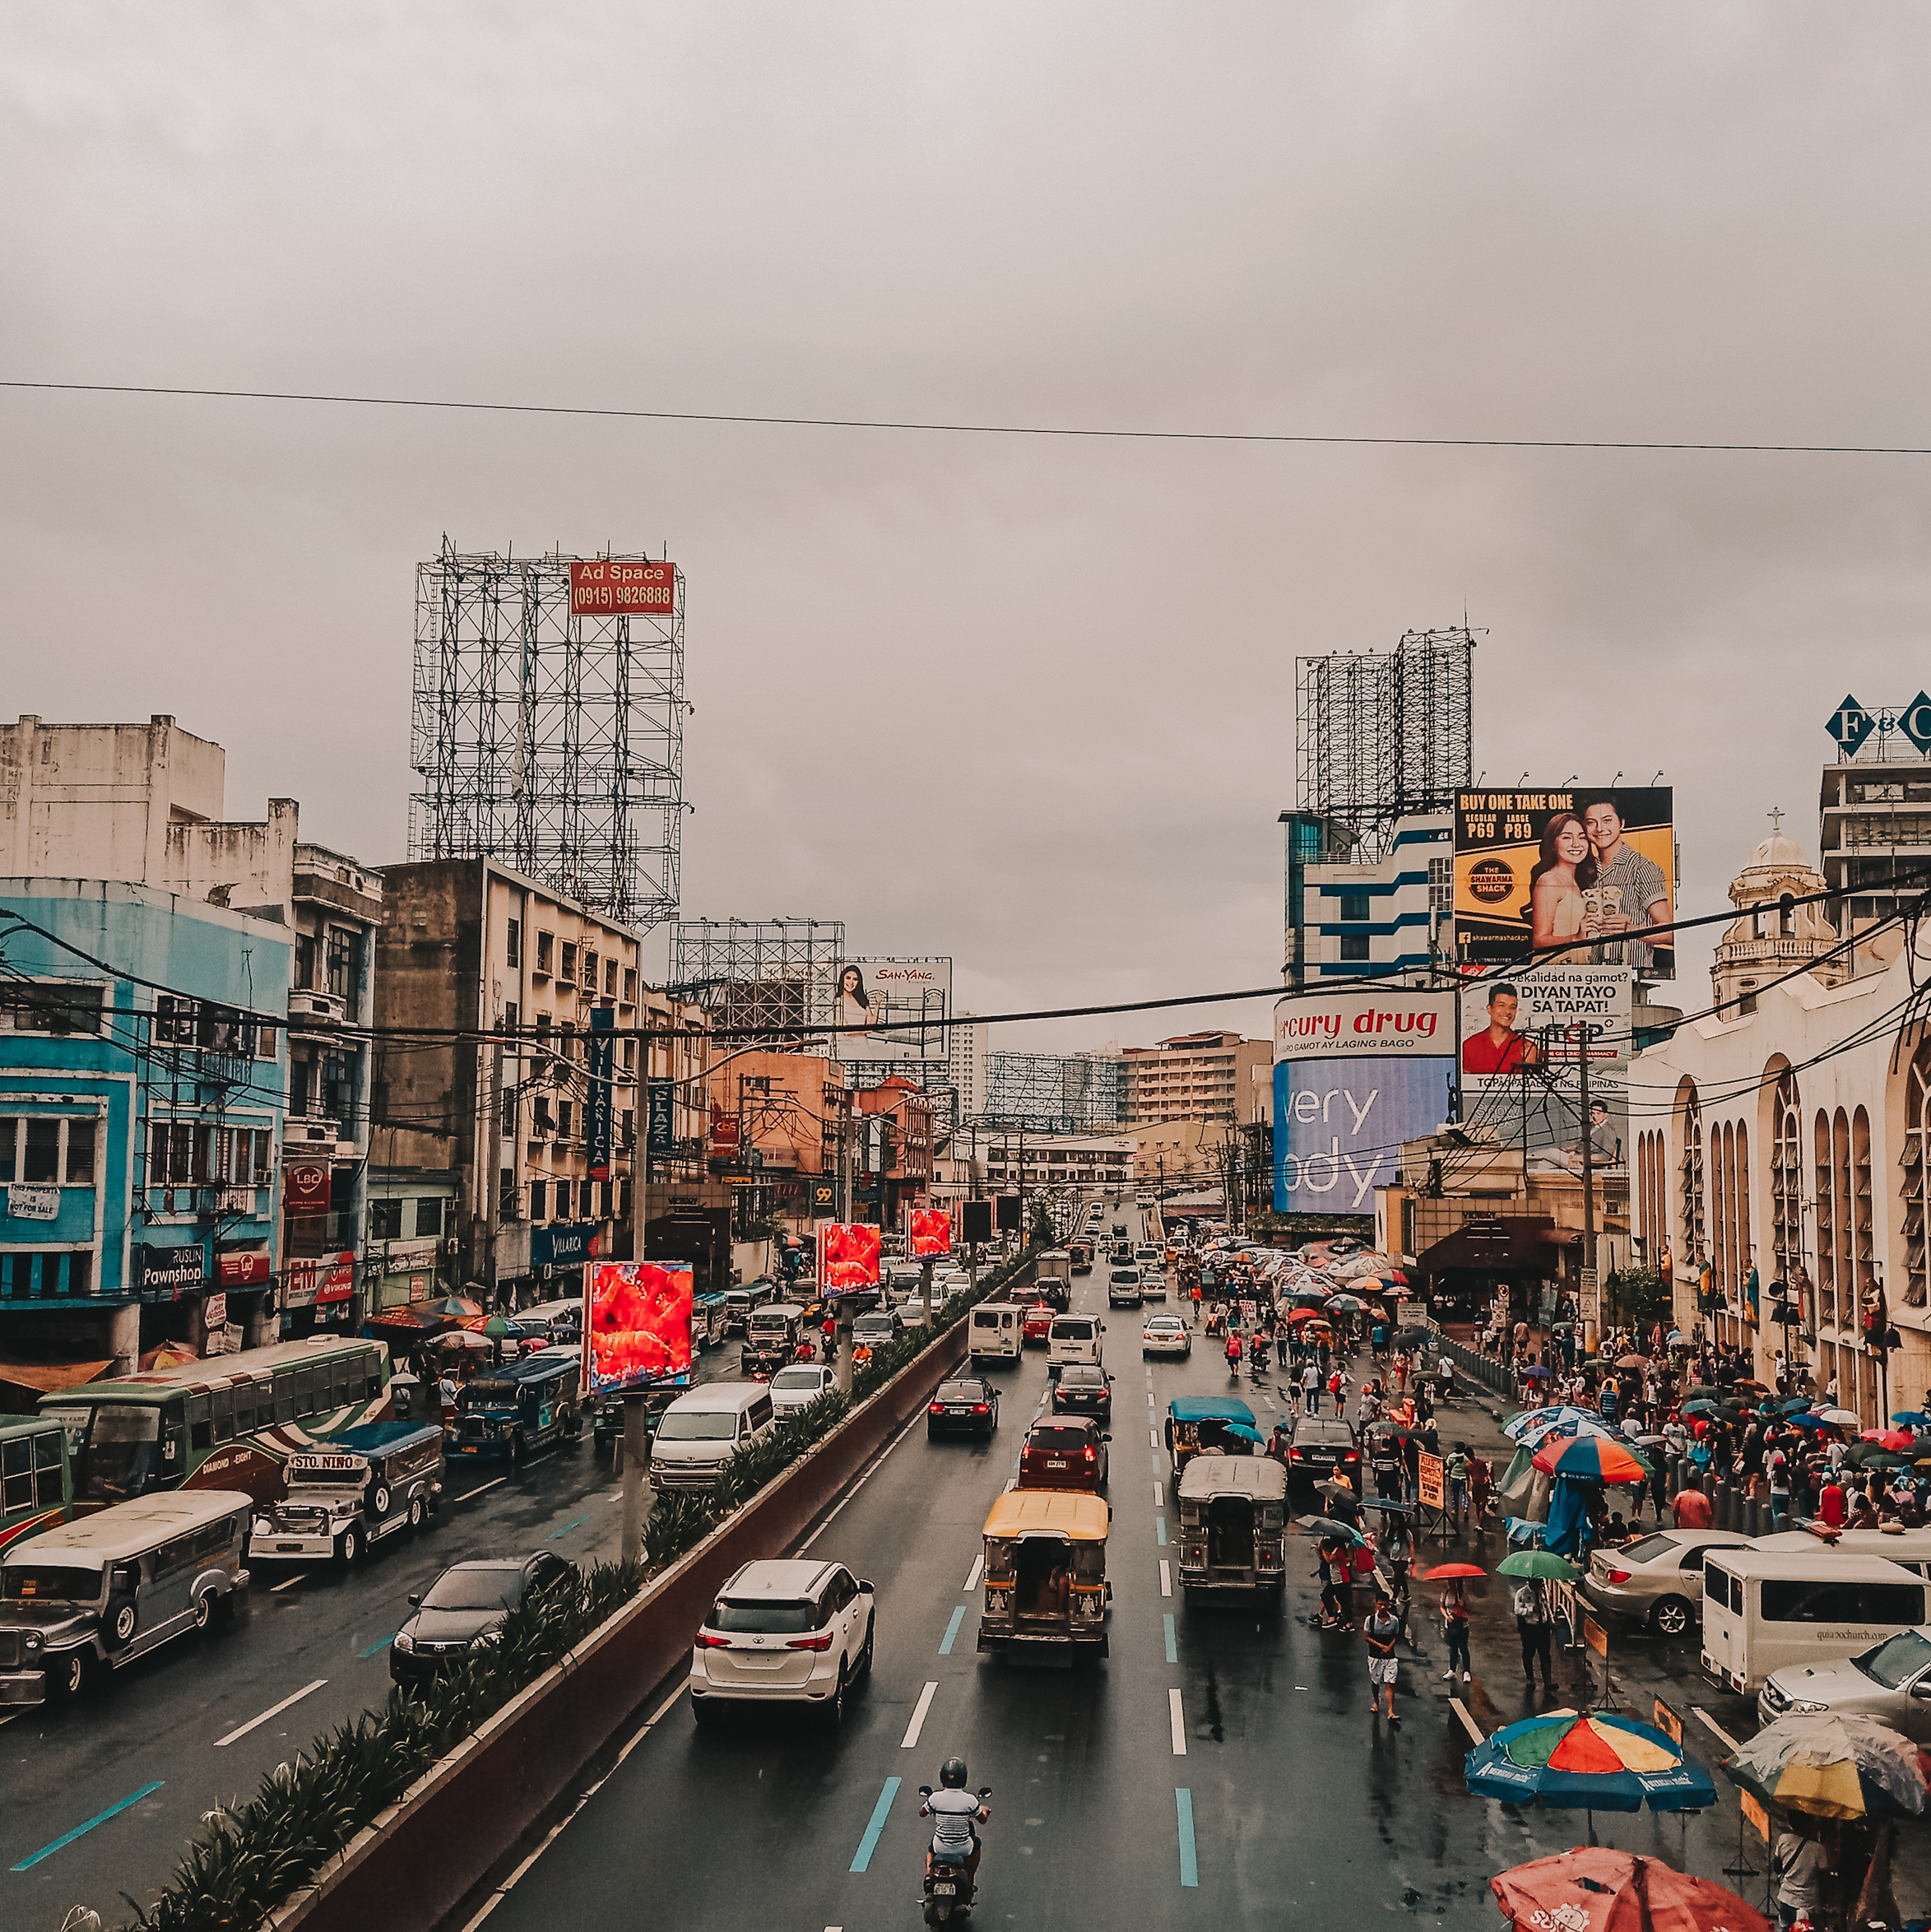
B
akit
mahirap ang mga
Pilipino?
(The Relationship Between Filipino Income and Expenditures: A Multivariate Analysis)
Presented by:
Group 5 - Data Explorers

Slide 2
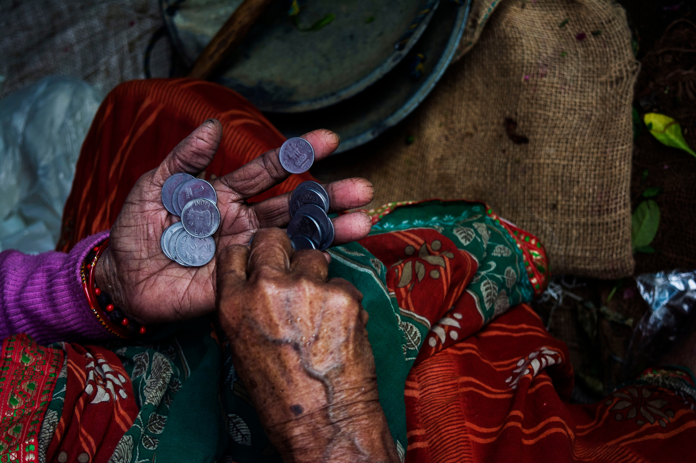
Background
of the Study
Poverty is defined as the state or condition where people and communities cannot meet a minimum standard of living because they lack the proper resources. This can include things like food, clothing, shelter, healthcare, education, and access to other basic necessities.
Source: Peace, dignity and equality on a healthy planet
Notes:
Poverty is defined as the state or condition where people and communities cannot meet a minimum standard of living because they lack the proper resources. This can include things like food, clothing, shelter, healthcare, education, and access to basic necessities.

Slide 3
Poverty in the
Philippines
Poverty incidence among population is at 16.6% in 2018 or 17.6 million Filipinos who lived below the poverty threshold estimated at PhP 10,727, on average, for a family of five per month.
Poverty Incidence is the proportion of poor Filipinos whose per capita income is insufficient to meet their basic food and non-food needs
Source: Updated 2015 and 2018 Full Year Official Poverty Statistics
Notes:
Data is from 2018 from PSA, hence sources are also from that year to have our RRL and analysis coherent

Slide 4
Poverty in the
Philippines
The subsistence incidence among Filipinos, or the proportion of Filipinos whose income is not enough to meet even the basic food needs, was registered at 5.2 percent in 2018. This means that 6.5 million Filipinos were unable to meet their basic food needs in 2018.
Source: Updated 2015 and 2018 Full Year Official Poverty Statistics

Slide 5
Poverty in the
Philippines
Causes of poverty in the Philippines
Low economic growth
Lack of Education
Unemployment and underemployment
Inequality / Social Exclusion
Source: Updated 2015 and 2018 Full Year Official Poverty Statistics

Slide 6
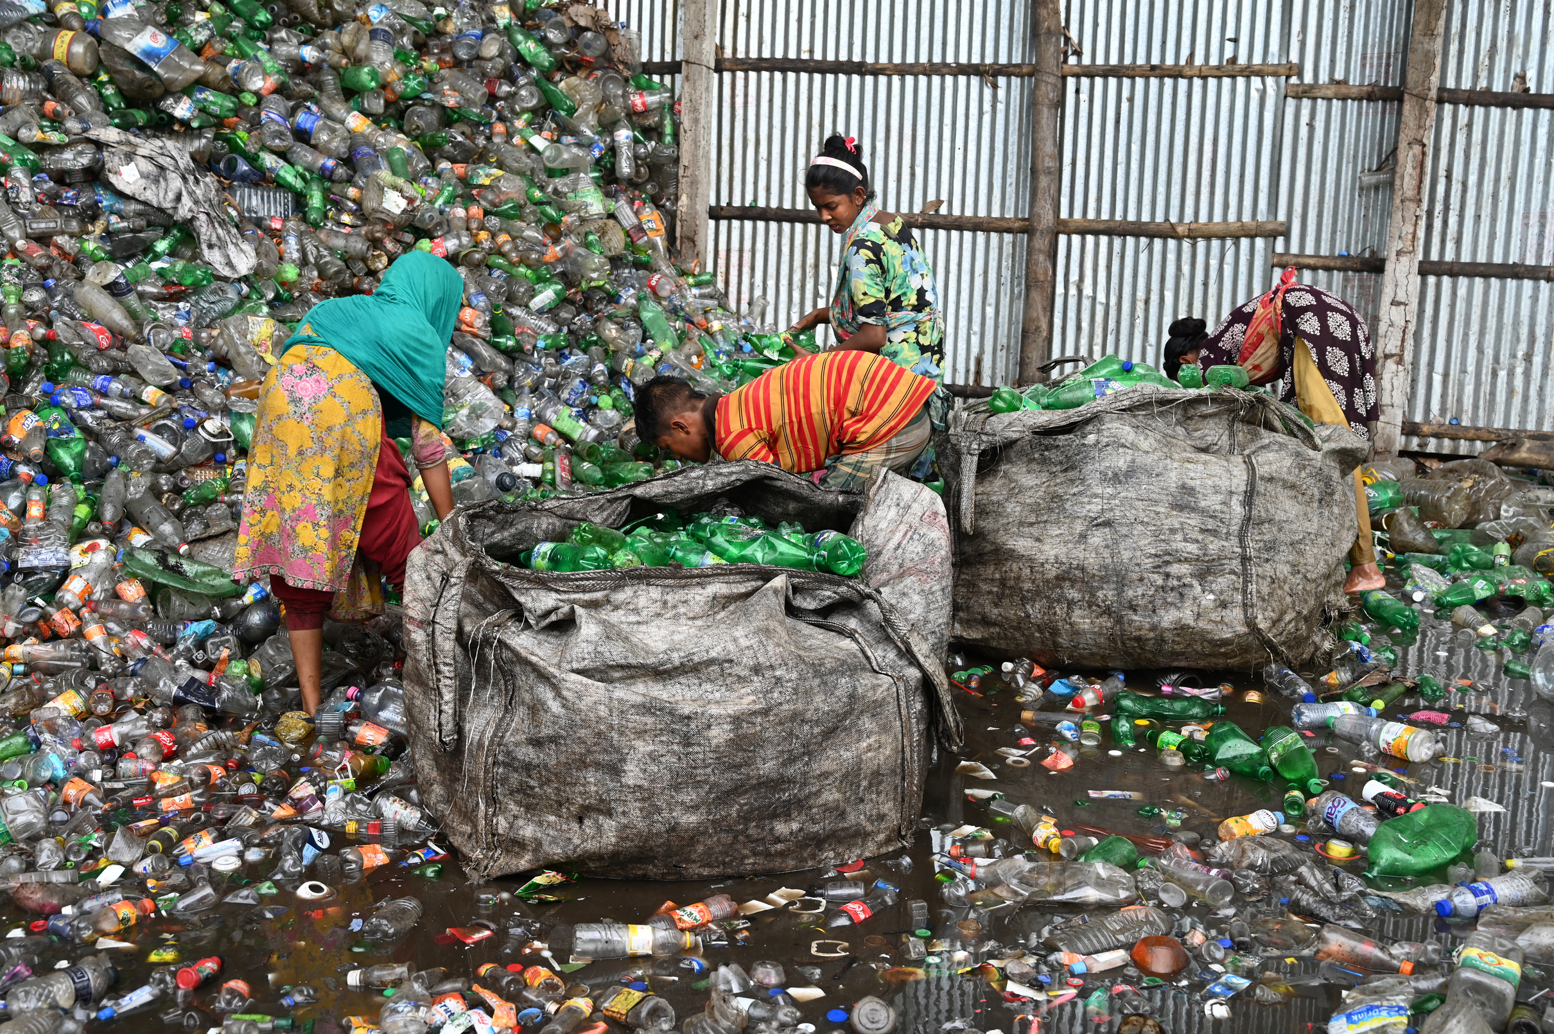
Statement of the Problem
The Philippines has a high poverty rate, with about 16.6% of the population living below the poverty line. There is a need to understand the factors that contribute to poverty in the Philippines, in order to develop effective policies to alleviate it.
By understanding how income and expenditures are related, researchers can gain a better understanding of the causes of poverty, measure the impact of poverty alleviation programs, and target these programs to the groups that are most in need.

Slide 7
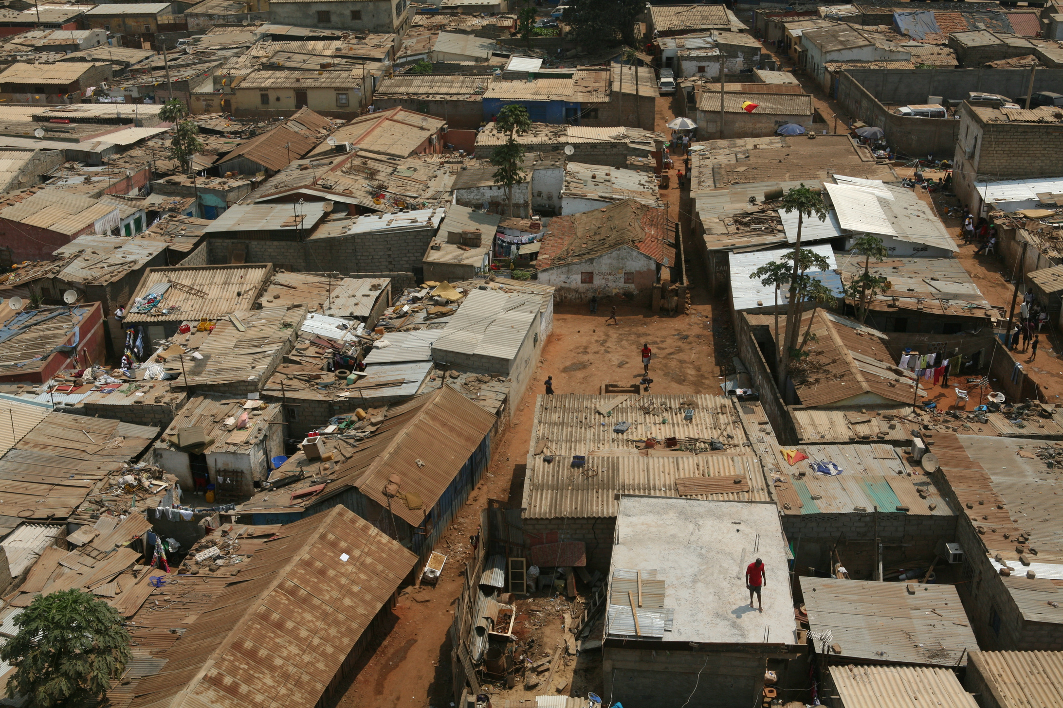
Research
Questions
How poor is the Philippines?
What is the relationship between Filipino income and expenditures?
How the income affects the living of the Filipino household?
What are the factors that influence the relationship between Filipino income and expenditures?

Slide 8
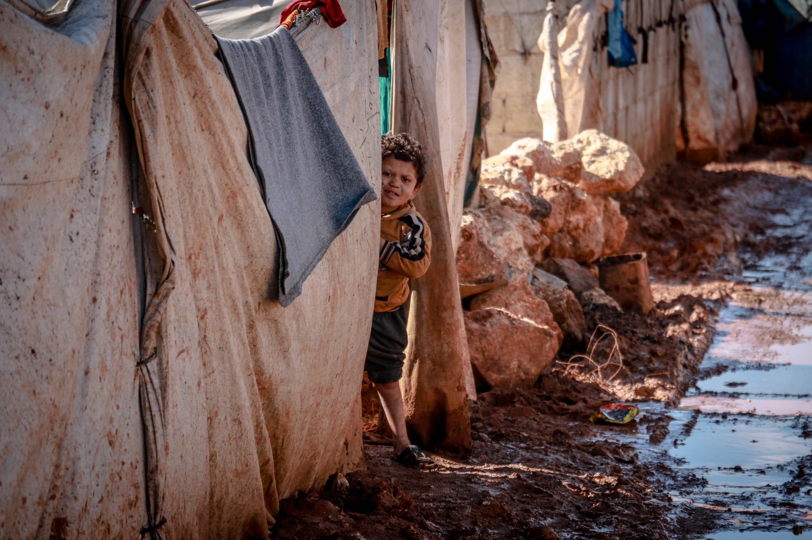
The Methodologies

Slide 9
Data collection
The raw dataset is from a 2018 nationwide Family Income and Expenditure Survey (FIES) conducted every three (3) years by the Philippine Statistics Authority.
The raw dataset has 41544 instances and 60 features.
Source: Kaggle - Filipino Family Income and Expenditure

Slide 10
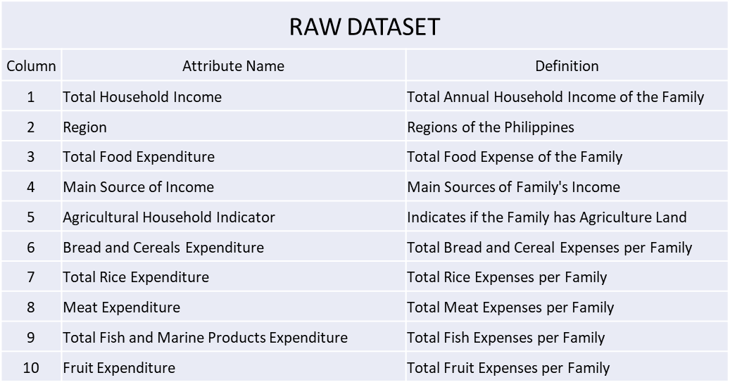
DATA dictionary
Create a data dictionary for all the features to better understand the dataset.
First 10 features of the raw dataset

Slide 11
DATA CLEANING
Identify and remove all irrelevant features of the dataset, we have removed a total of 31 features from the dataset.
Identify and remove duplicate values in the dataset. The dataset has 0 duplicate values.
Identify null values and fill with a relevant value. We identified null values in Household Head Occupation and Household Head Class of Worker and filled the null values with “Unemployed”.

Slide 12
DATA WRANGLING
Group related values and change to a common value for a better analysis of the data. For example;
In the column ‘Household Head Highest Grade Completed’, we found that it has the values,‘Grade 1’, ‘Grade 2’, ‘Grade 3’, ‘Grade 4’, ‘Grade 5’ and ‘Grade 6’. We then group and changed the value with ‘Elementary Undergraduate’.

Slide 13
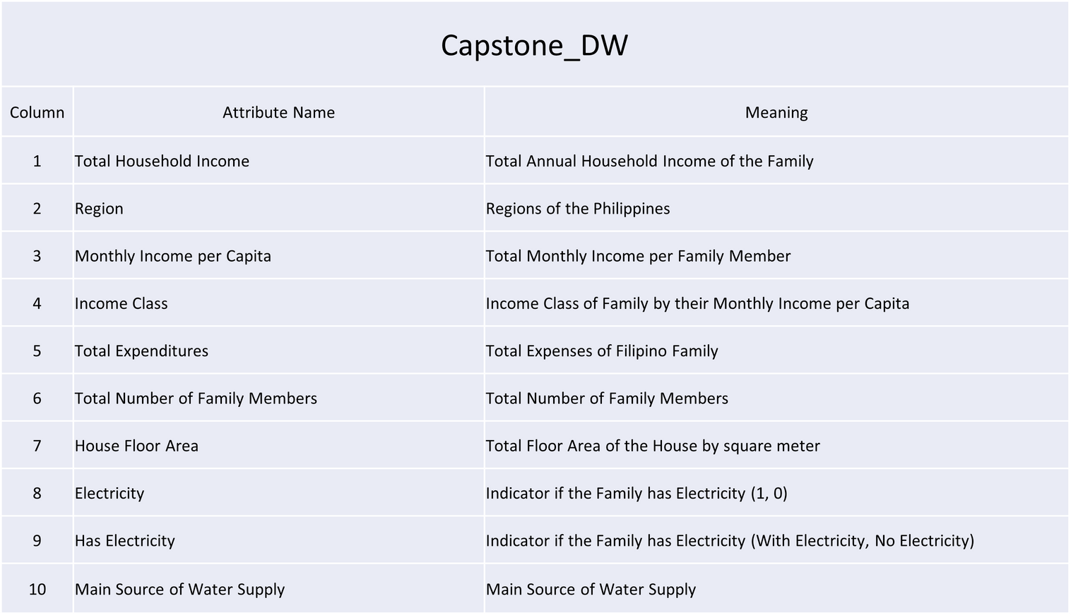
cleaned DATAset
This dataset will be used for the data analysis of the study:

Slide 14
DATA analysis
Quantitative data analysis, correlation analysis and graphical methods will be used to identify patterns in the dataset. The findings will be concluded in a report, which will provide insights to inform the public on what is the status of the social economy in 2018.

Slide 15
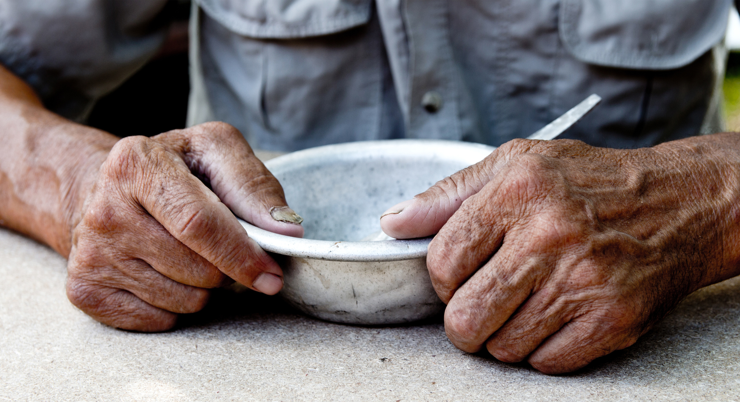
Results and
Insights
Source: Kaggle - Filipino Family Income and Expenditure

Slide 16
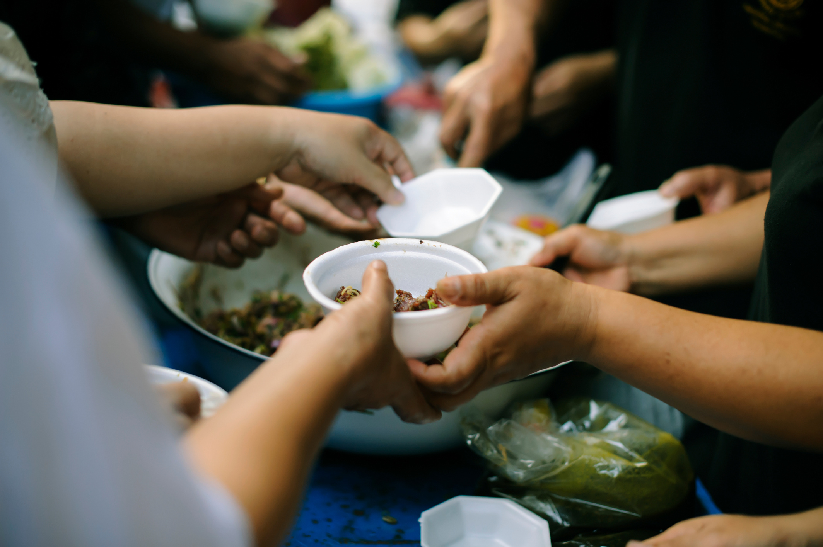

income class distribution
According to the our study, majority of the Filipino are poor comprising 60.7% of the total population or a value equivalent to 25,228. Consider below 30 families:
Source: Kaggle - Filipino Family Income and Expenditure

Slide 17

income class distribution
According to the our study, majority of the Filipino are poor comprising 60.7% of the total population or a value equivalent to 25,228. Consider below 30 families:
Source: Kaggle - Filipino Family Income and Expenditure

Slide 18


income class distribution
According to the our study, majority of the Filipino are poor comprising 60.7% of the total population or a value equivalent to 25,228. Consider below 30 families:
Source: Kaggle - Filipino Family Income and Expenditure

Slide 19

income class distribution
According to the our study, majority of the Filipino are poor comprising 60.7% of the total population or a value equivalent to 25,228. Consider below 30 families:
Source: Kaggle - Filipino Family Income and Expenditure

Slide 20
Expenditure vs Income
1,500,000
1,000,000
500,000
0
Poor
Middle Class
Rich
TOTAL INCOME
TOTAL EXPENDITURE
Source: Kaggle - Filipino Family Income and Expenditure

Slide 21
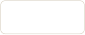


Expenditure vs Income
Poor
-0.00453
Result shows that the income accumulated by the poor annually and in average is not enough to sustain the family comparable to the middle and the rich
Middle Class
0.71371
Rich
0.4694
Source: Kaggle - Filipino Family Income and Expenditure

Slide 22
Main source of income distribution
Income source distribution shows that most of the population is dependent on Other sources of income (i.e freelancing and other side jobs). Comprising 49.1% or 20,387 households practicing it.
26.1%
Entrepreneurial Activities
Other
49.1%
While most the Filipinos are practicing Other activities, 24.8% (10,320) are still dependent on Salary alone while 26.1%(10,836) are doing Entrepreneurial or Business activities.
24.8%
Wage/Salary
Source: Kaggle - Filipino Family Income and Expenditure

Slide 23
educational attainment comparison
10,000
9,628
7,500
8,821
8,194
7,640
5,000
5,516
1,228
2,500
The majority of household heads held a high school diploma, stopping their studies without pursuing a degree program, while 1,228 household heads or 2.96% of the population didn't have a chance to attend school.
0
Degree Programs
High School Graduate
Elementary Graduate
No Grade Completed
Elementary Undergraduate
High School Undergraduate
Source: Kaggle - Filipino Family Income and Expenditure

Slide 24


job comparison: unschooled
With Jobs/Business
The majority of the unschooled household heads are with jobs or business of their own, comprising 78.4% or 963 heads comparable to the 265 who does not.
78.4%
Without Jobs/Business
21.6%
Source: Kaggle - Filipino Family Income and Expenditure

Slide 25

basic necessities: electricity
Electricity is the supply of electric current to a house or other building for heating, lighting, or powering appliances
Source: Kaggle - Filipino Family Income and Expenditure

Slide 26

basic necessities: electricity
Data shows that 1 out of 10 houses in the Philippines has no electricity. In totality, the number of houses without electricity in the country is 10.9% or 4,536 households.
Source: Kaggle - Filipino Family Income and Expenditure

Slide 27

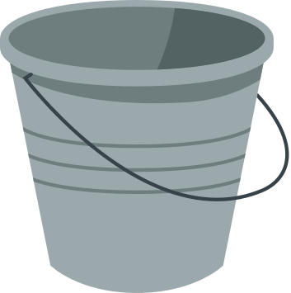
basic necessities: water
Water is one of the basic necessities needed for a household to thrive. For Filipinos, water is the lifeline of businesses and households. Four of the main supplies of water in the country
are as follows: household faucets and deep well, both are either owned or shared.
16,093
6,242
4,614
4,587
Faucet-Owned
Deep well - Shared
Faucet-Shared
Deep well - Owned
Source: Kaggle - Filipino Family Income and Expenditure

Slide 28


basic necessities: housing
In accordance with PD1096 or most commonly known as the National Building Code (NBC), a certain land area is dedicated to a person for his living to be considered comfortable. In the instance of NBC, it should be 0.65sqm per person.
Data shows that 2.48% of the population is still without a suitable housing area to properly accommodate a family. In values, 2.48% is equivalent to 1,031 households.
2.48%
97.5%
Source: Kaggle - Filipino Family Income and Expenditure

Slide 29
Key Insight:
The rich are able to save more money than the middle class and the poor.
The income-to-expenditures ratio of the following:
Rich - 0.47, which means that they are able to save 53.00% of their income.
Middle class - 0.71, which means that they are able to save 29.00% of their income.
Poor - 0.00453, which means that they are not able to save any money and may even have to borrow money to make ends meet
Source: Kaggle - Filipino Family Income and Expenditure
Notes:
Poverty in the Philippines is a complex issue with many contributing factors. However, this study finds and confirms that one of the key factors is the huge disparity between income and expenses especially in the Lower and Middle Classes.

Slide 30
Conclusions
The huge disparity of income and expenses in poverty in the Philippines has a number of negative effects, including:
Increased poverty further
Increased inequality / social exclusion (no access to basic necesities)
Reduced economic growth
Decreased social mobility
Source: Kaggle - Filipino Family Income and Expenditure
Notes:
The huge disparity of income and expenses in poverty in the Philippines has a number of negative effects, including:
Increased poverty: The poorest Filipinos are unable to meet their basic needs, such as food, shelter, and healthcare. This can lead to malnutrition, illness, and even death.
Increased inequality: The gap between the rich and the poor is widening, which can lead to social unrest and political instability.
Reduced economic growth: When the poor are unable to participate fully in the economy, it can slow down economic growth.
Increased crime: Poverty can be a major driver of crime, as people who are desperate for money may turn to illegal activities.
Decreased social mobility: The poor are less likely to be able to move up the economic ladder, which can lead to a cycle of poverty that is difficult to break.

Slide 31
Conclusions
Addressing poverty in the Philippines:
Promote economic growth
Invest in education and job trainings
Reform government policies that provide the basic necessities for Filipino families
Strengthen social safety nets
Source: Kaggle - Filipino Family Income and Expenditure
Notes:
General steps in terms of
Promote economic growth: Economic growth is essential for creating jobs and opportunities for the poor. The government can promote economic growth by investing in infrastructure, education, and healthcare. It can also create a business-friendly environment by reducing taxes and regulations.
Invest in education and healthcare: Education and healthcare are essential for improving the skills and productivity of the poor. The government can invest in education by providing free or subsidized education at all levels. It can also invest in healthcare by providing universal health care coverage.
Reform government policies: Government policies should be fair and equitable, and they should not benefit the wealthy at the expense of the poor. The government can reform government policies by simplifying the tax system, reducing corruption, and ensuring that everyone has access to basic services.
Strengthen social safety nets: Social safety nets, such as social assistance programs and public works projects, can help to provide a basic level of support for the poor. The government can strengthen social safety nets by expanding existing programs and creating new ones.

Slide 32
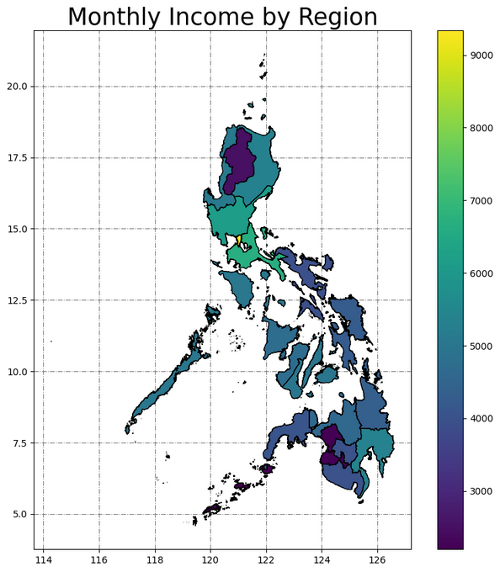
Recommendations
Get updated survey from PSA
Add Geomapping for future studies as it can help identify the spatial distribution of poverty and the factors that contribute to it per region
Sectors / industries (agriculture, BPO, IT, ect) that are being focused on of different regions
The use of a gender lens: A gender lens can help to identify the different ways that poverty affects men and women
Source: Kaggle - Filipino Family Income and Expenditure
Notes:
The disparity in income and expenditures between the rich, middle class, and poor in the Philippines is a complex issue with no easy solutions. However, by understanding the factors that contribute to this disparity, we can begin to develop policies and programs that can help to alleviate poverty and improve the lives of all Filipinos.

